Slide 1
Digital Tools
Click on the link below to go straight to your area of interest
USING VIDEO
RECORDING VIDEO CONFERENCES
ACCESSIBLE POWERPOINTS
USING PADLET
We also have a set of resources for CREATING STOP ANIMATION STORIES on our website

Slide 2
USING VIDEO
Which tool to use depends on which Version of Windows you are using. If you don't know which version of Windows your device is running, press the Windows logo key and R at the same time, type winver in the Open box, and then select OK.
If you are using Windows 10, the best choice is the inbuilt Photos app.
If you're using an older version of Window, the best choice is MovieMaker.

Slide 3
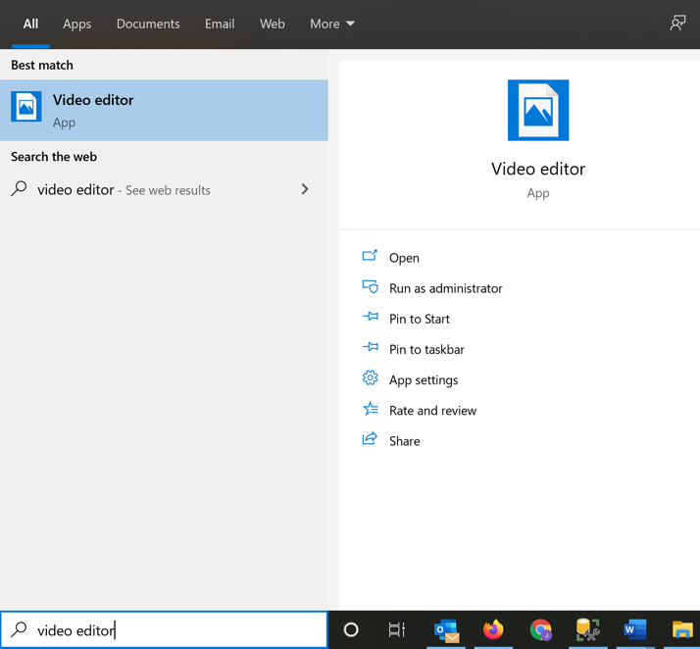
USING PHOTOS
To access Photos, type video editor into the search box at the bottom left of your screen, and select the Video Editor app
This will take you into the Photos app.

Slide 4
USING PHOTOS
From the main screen, click on Video Projects, and then click on the New Video Project button to get started.

Slide 5
USING PHOTOS
There's a guide to creating a video in the Photos app at https://support.microsoft.com/en-us/help/17205/windows-10-create-videos

Slide 6
RECORDING VIDEO CONFERENCES
How to record video conferences on a variety of different platforms, and how to get the resulting video files
Click on the link below to go straight to the specific platform
MICROSOFT TEAMS
ZOOM
SKYPE

Slide 7
RECORDING A TEAMS MEETING
First follow these instructions: How to record a meeting in Microsoft Teams
To retrieve the video file: Teams will store the video file in Microsoft Stream after the meeting ends. It takes a few minutes for the file to get created. If you are the meeting organiser, you should get an email with a link to the recording after the meeting. You can access Microsoft Stream from 365 by clicking on the 9 dot menu in the top left of your browser and then clicking All Apps

Slide 8
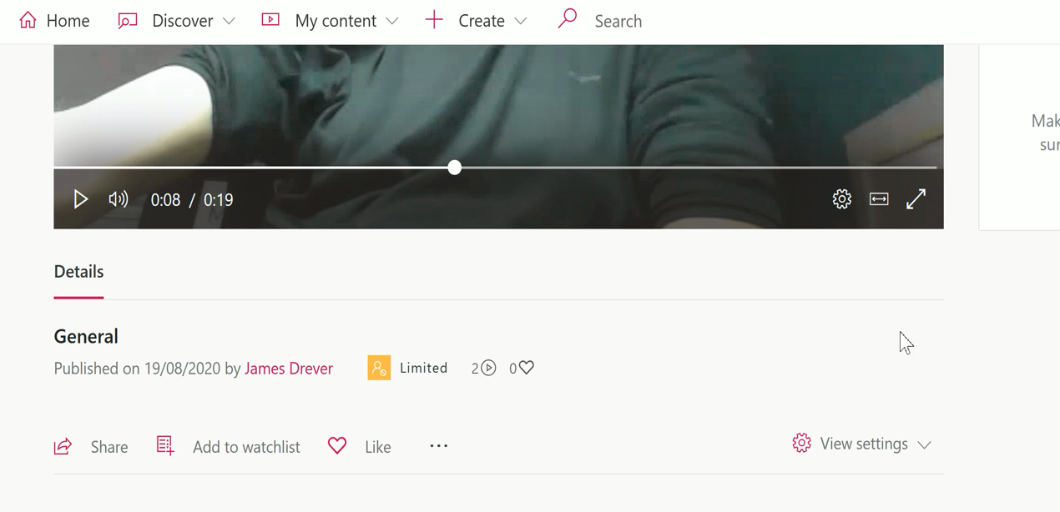
RECORDING A TEAMS MEETING
In Stream you can download the video by clicking on the three bar icon and selecting Download video (double click the video below to play).

Slide 9
RECORDING A ZOOM MEETING
First follow these instructions: How to record a meeting in Zoom
To retrieve the video file: From your Zoom account, you can navigate to Recordings in the left hand panel, then the Local recordings tab, find your recording, and then either use the location to find your files on your local computer, or copy and paste the file location into Explorer.

Slide 10
RECORDING A SKYPE MEETING
First follow these instructions: How to record a meeting in Skype
To retrieve the video file: the video should be posted to your chat in Skype

Slide 11
CREATING ACCESSIBLE POWERPOINTS
Powerpoints are a very widely used way of communicating and can be a good way of structuring a story. Here you will find some guidance on how to make Powerpoints that are accessible to the widest audience.

Slide 12
DESIGNING YOUR POWERPOINTS TO BE ACCESSIBLE
The following tips should ensure your Powerpoint is more accessible:
Make sure your text and background use contrasting colours so the content is clearly visible, and that the font size of text is sufficiently large to be easy to read.
It is helpful to use the built in Powerpoint layouts, with title and content placed in the appropriate boxes, as this helps when someone accesses the Powerpoint using a screen reader.

Slide 13
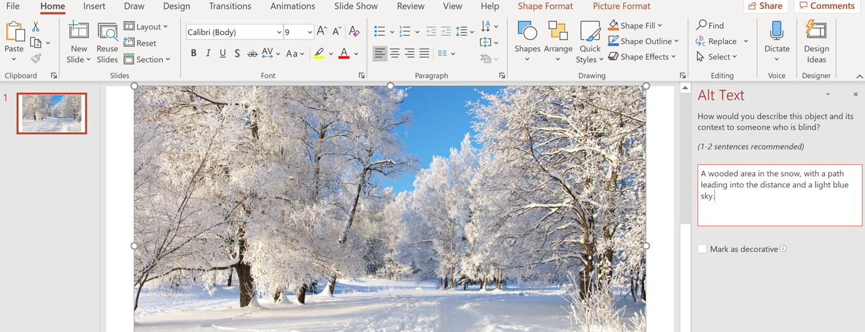
MAKING IMAGES OR VIDEOS ACCESSIBLE
When you are adding images or videos to a Powerpoint, you can add Alt text by right clicking the image or video and selecting Edit Alt Text.

Slide 14
USING PADLET
Padlet is a really useful tool for collaborating and sharing ideas. We think it could be particularly useful for the activities in Parts 1 and 2.
In terms of Part 3 and the creation of the digital stories, Padlet may be an appropriate tool, but be aware that to share your Padlet with an audience outside of the your school, the Padlet will need to be configured to be publicly accessible.

Slide 15
USING PADLET
Also please be aware that currently, the accessibility of Padlet content for people with disabilities isn't perfect.
Padlet now has a built-in feature for creating timelines. You can read more about it on the Padlet blog.

